Slide 1
JAVASCRIPT
LESSON 3
FUNCTION

Slide 2
Lesson 3
Function
  without argument
  with argument
  with returning value
Form Validation
Using Javascript to Create Small Web-based Application
  BMI Calculator
  Currency Converter

Slide 3
Function without Arguments
<html>
<title>Introduction to Function</title>
<head>
<script language = “JavaScript”>
//Function to greet
function greet()
{
document.write(“Assalamulaikum, welcome to my blog”);
}
//function message
function message()
{
document.write(“I want to share my ups and down of my life with you readers out there”);
}
</script>
</head>
<body>
<script language =“JavaScript”>
greet();
</script>
<hr>
<script language =“JavaScript”>
message();
</script>
</body>
</html>

Slide 4
Function with Arguments
A function can have arguments passed to it to perform calculation
<html>
<body>
<script>
function add(x, y){
alert(x+y);
}
function mul(x, y){
return x*y;
}
function calc(){
var t=parseInt(document.getElementById("t").value);
var m=parseInt(document.getElementById("m").value);
var s=parseInt(document.getElementById("s").value);
if (s==1) add(t,m);
else alert(mul(t,m));
}
</script>
<table>
<tr>
<td><b><input type=number id=t></b></td>
<td><b><input type=number id=m></b></td>
</tr>
<tr>
<td><select id=s>
<option value=1>Add</option>
<option value=2>Multiply</option>
</select>
</td>
<td><button onClick="calc();">Submit</button></td>
</tr>
</table>
</body>
</html>

Slide 5
Function with Returning Value
From the previous example, the add function does not return a value
Function mul however returns a value
If function mul is called from within javascript, it will return the value into the parent script that called it.

Slide 6
Form Validation
Forms can be checked by JavaScript prior to submission for errors
<!DOCTYPE html>
<html>
<head>
<script>
function validateForm() {
var x = document.forms["myForm"]["fname"].value;
if (x == "") {
alert("Name must be filled out");
return false;
}
}
</script>
</head>
<body>
<form name="myForm" action="/action_page.php" onsubmit="return validateForm()" method="post">
Name: <input type="text" name="fname">
<input type="submit" value="Submit">
</form>
</body>
</html>

Slide 7
Form Validation
In the previous example, if the form was not filled, an alert stating the error will be displayed
The form will not be posted for as long as the error is not corrected, or the function still returns false

Slide 8
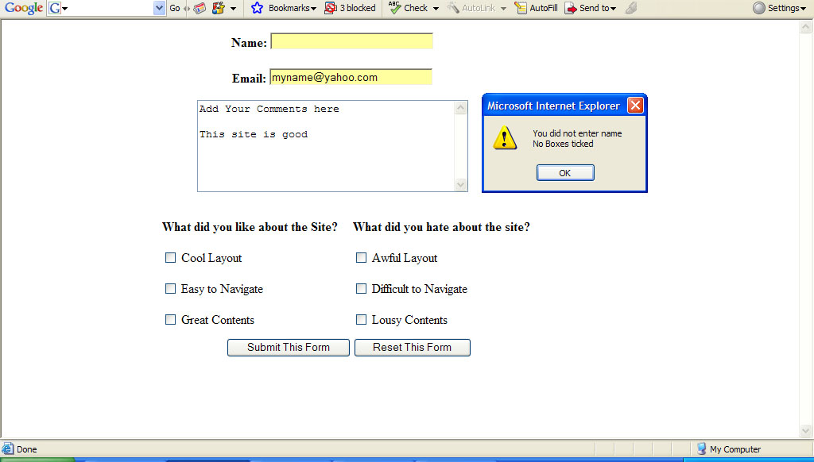

Slide 9
The Date Object
The Date object is crucial in JavaScript to display both the date and time
To declare a Date object, constructor new is mandatory
The Date object is case-sensitive
There are four ways to declare a Date
var d = new Date();
new Date()
new Date(year, month, day, hours, minutes, seconds, milliseconds)
new Date(milliseconds)
new Date(date string)

Slide 10
Get Date Methods
There are numerous methods you can use to display date to your liking
Method | Description
getFullYear() | Get the year as a four digit number (yyyy)
getMonth() | Get the month as a number (0-11)
getDate() | Get the day as a number (1-31)
getHours() | Get the hour (0-23)
getMinutes() | Get the minute (0-59)
getSeconds() | Get the second (0-59)
getMilliseconds() | Get the millisecond (0-999)
getTime() | Get the time (milliseconds since January 1, 1970)
getDay() | Get the weekday as a number (0-6)
Date.now() | Get the time. ECMAScript 5.

Slide 11
Example
<!DOCTYPE html>
<html>
<head>
<script>
function startTime() {
var today = new Date();
var h = today.getHours();
var m = today.getMinutes();
var s = today.getSeconds();
m = checkTime(m);
s = checkTime(s);
document.getElementById('txt').innerHTML = h + ":" + m + ":" + s;
var t = setTimeout(startTime, 500);
}
function checkTime(i) {
if (i < 10) {i = "0" + i}; // add zero in front of numbers < 10
return i;
}
</script>
</head>
<body onload="startTime()">
<div id="txt"></div>
</body>
</html>

Slide 12
JAVASCRIPT
LESSON 4
MATH OBJECT

Slide 13
Math Object – method
The Javascript Math object has many methods associated with it.
Math.max() | return the larger of two numbers
Math.min() | return the smaller of two numbers
Math.pow() | return the power value
Math.random() | return random number in between 0.0 and 1.0
Math.round() | round up to the nearest integer
Math.ceil() | round a decimal number to the next higher integer
Math.floor() | round a decimal number to the lower integer

Slide 14
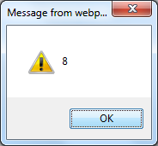
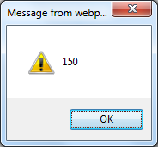
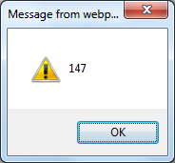
Example
alert(Math.pow(2,3));
alert(Math.max(150, 77));
alert(Math.round(146.889));

Slide 15
Example
Math.ceil() : Round up to next higher integer
    Math.ceil(2.456); //results 3
    Math.ceil(45.3); //results 46
    Math.ceil(0.000045); //results 1
    Math.ceil(146.889)); //results 147
Math.floor(): Round to lower integer
    Math.floor(2.456); //results 2
    Math.floor(45.3); //results 45
    Math.floor(0.000045); //results 0
    Math.floor(146.889)); //results 146

